Slide 1



Image Classification using TensorFlow Hub
Bhavesh Bhatt
Data Scientist, Colgate-Palmolive
India

Slide 2
“Don't reinvent the wheel, just realign it.” - Anthony J. D'Angelo

Slide 3
TensorFlow Hub

Slide 4
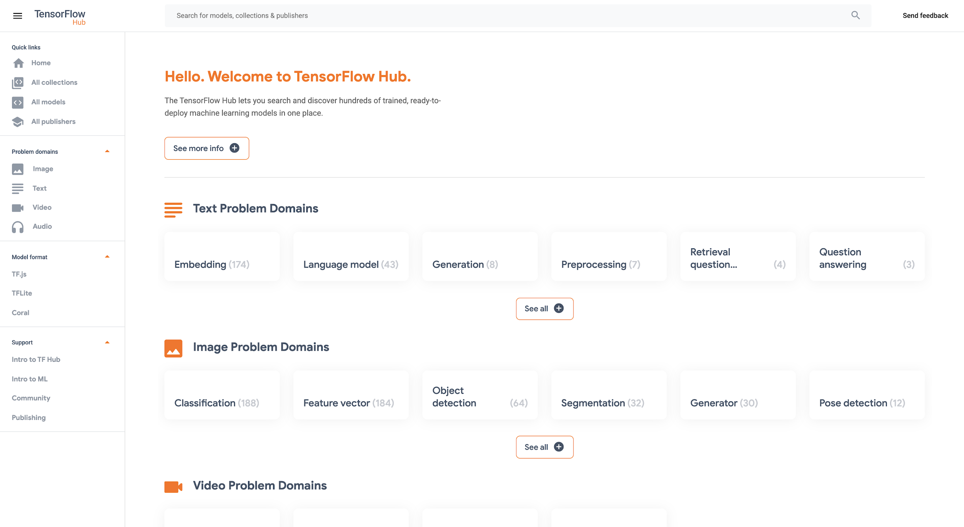
TensorFlow Hub

Slide 5
Text
Image
Video
Audio
TensorFlow Hub
Classification
Embeddings Generation
Question Answering
Classification
Object detection
Semantic segmentation
Style transfer
Classification
Generation
Classification
Embeddings / Features

Slide 6






Pre-trained models ready for transfer learning on your own datasets and deployable anywhere you want
TensorFlow Hub
Extended
.JS
Lite

Slide 7
How to use?

Slide 8
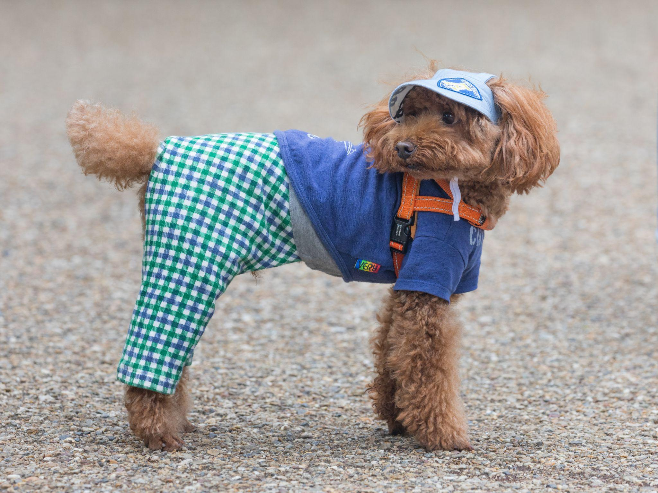
Image Source : Wikimedia.org

Slide 9
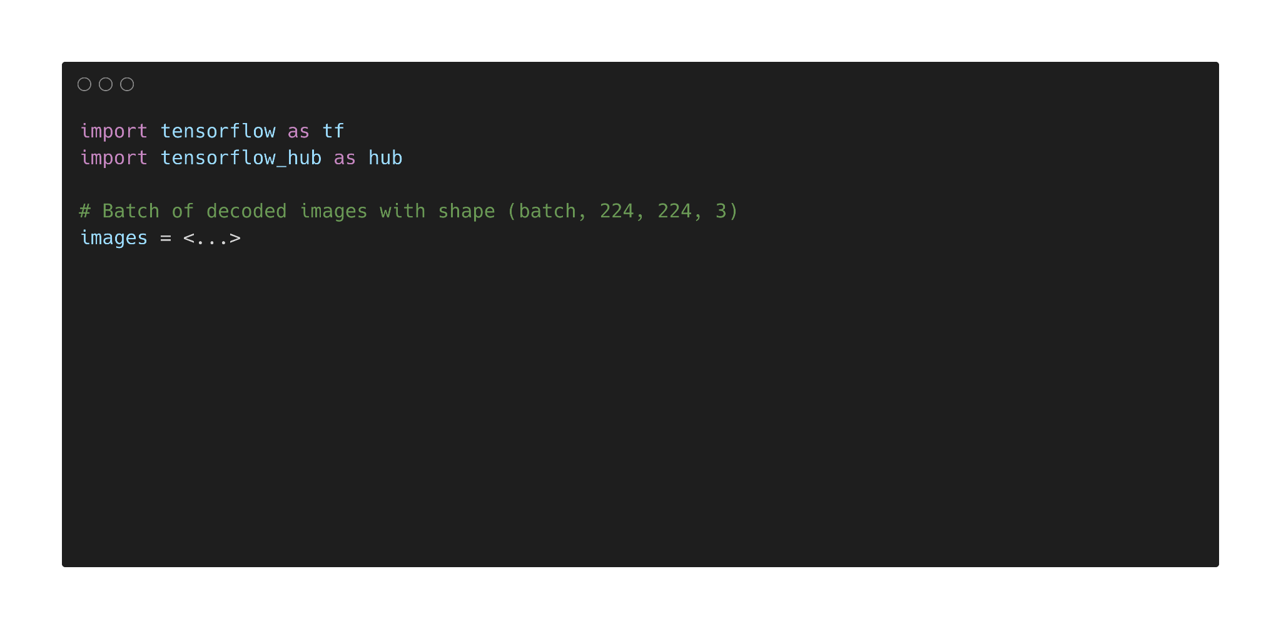

Slide 10
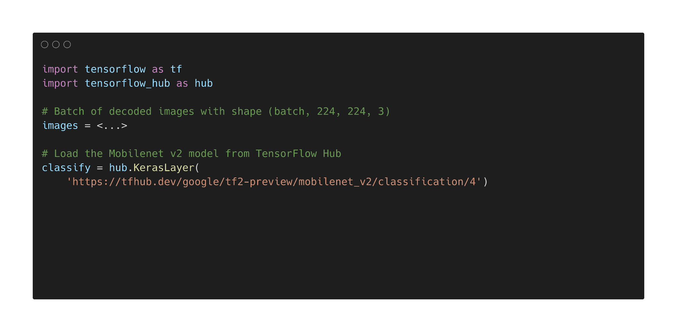

Slide 11
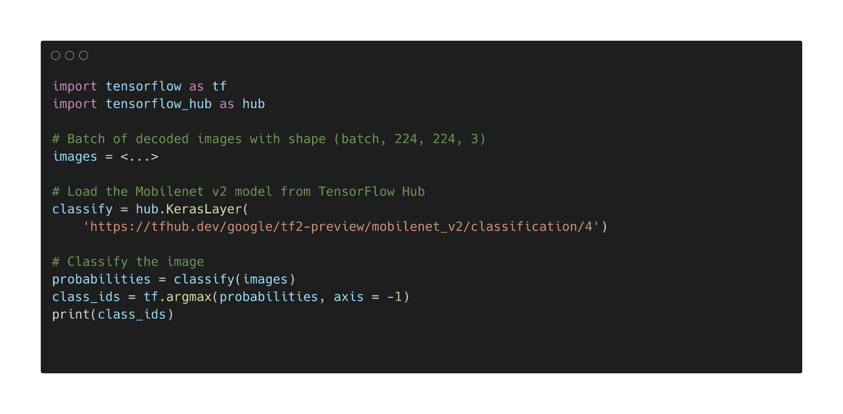

Slide 12
Class ID : 266
Class Name : Toy Poodle

Slide 13
Transfer Learning

Slide 14
Transfer Learning

Slide 15
Transfer Learning

Slide 16
Transfer Learning

Slide 17
Transfer Learning

Slide 18
Transfer Learning

Slide 19
Transfer Learning
Start
Obtain the pre-trained model
Create a base model
Freeze Layers
Train the new layers on the dataset
Improve the model via
fine tuning
End

Slide 20
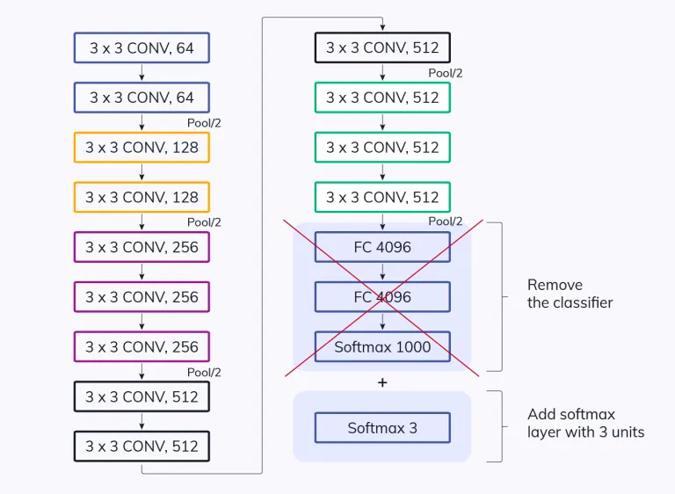
Transfer Learning

Slide 21
Transfer Learning Example

Slide 22
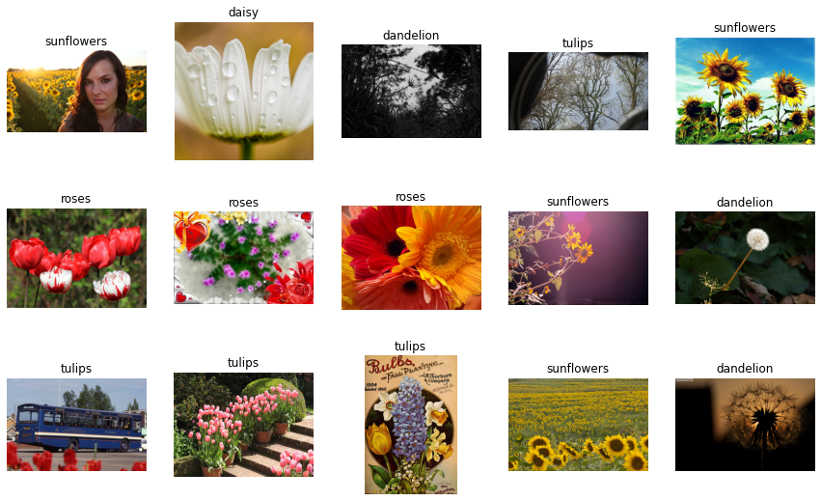
Image Source : TensorFlow.org

Slide 23
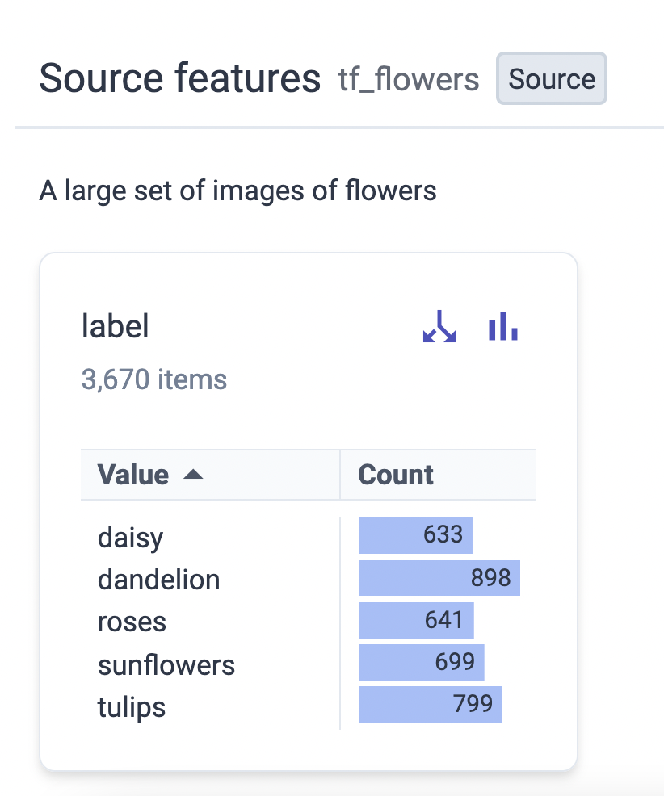
Image Source : Knowyourdata-tfds.withgoogle.com

Slide 24
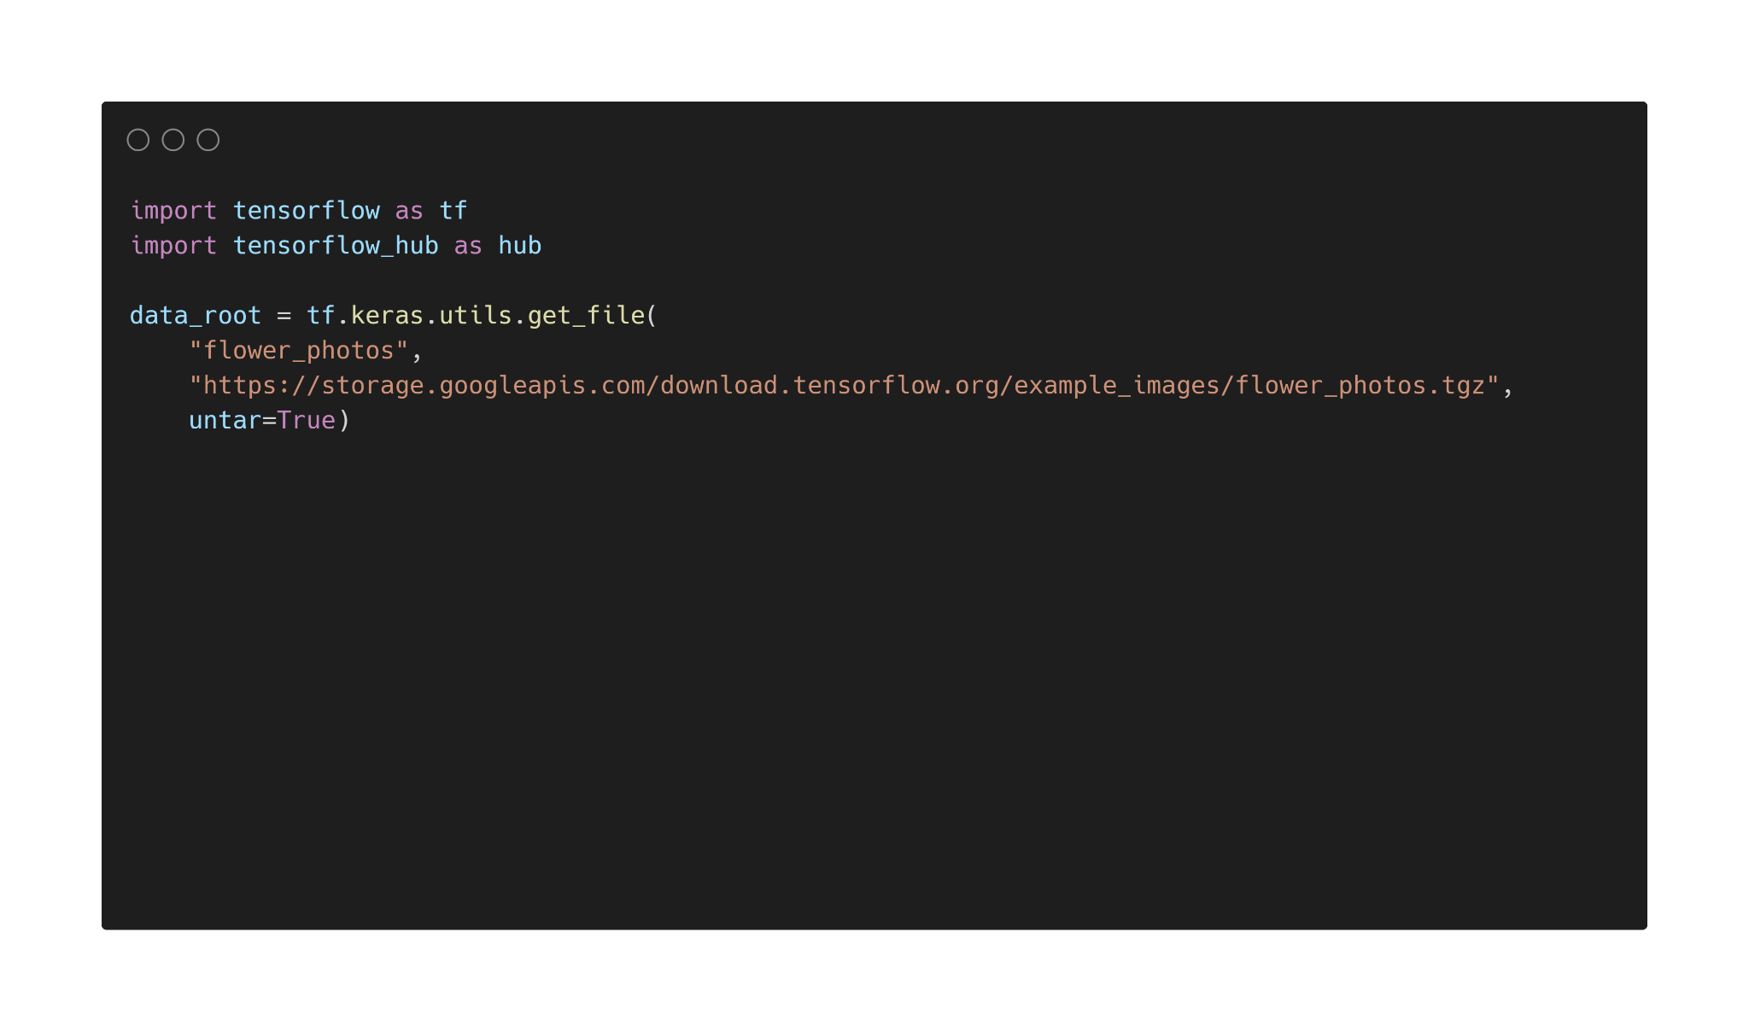

Slide 25
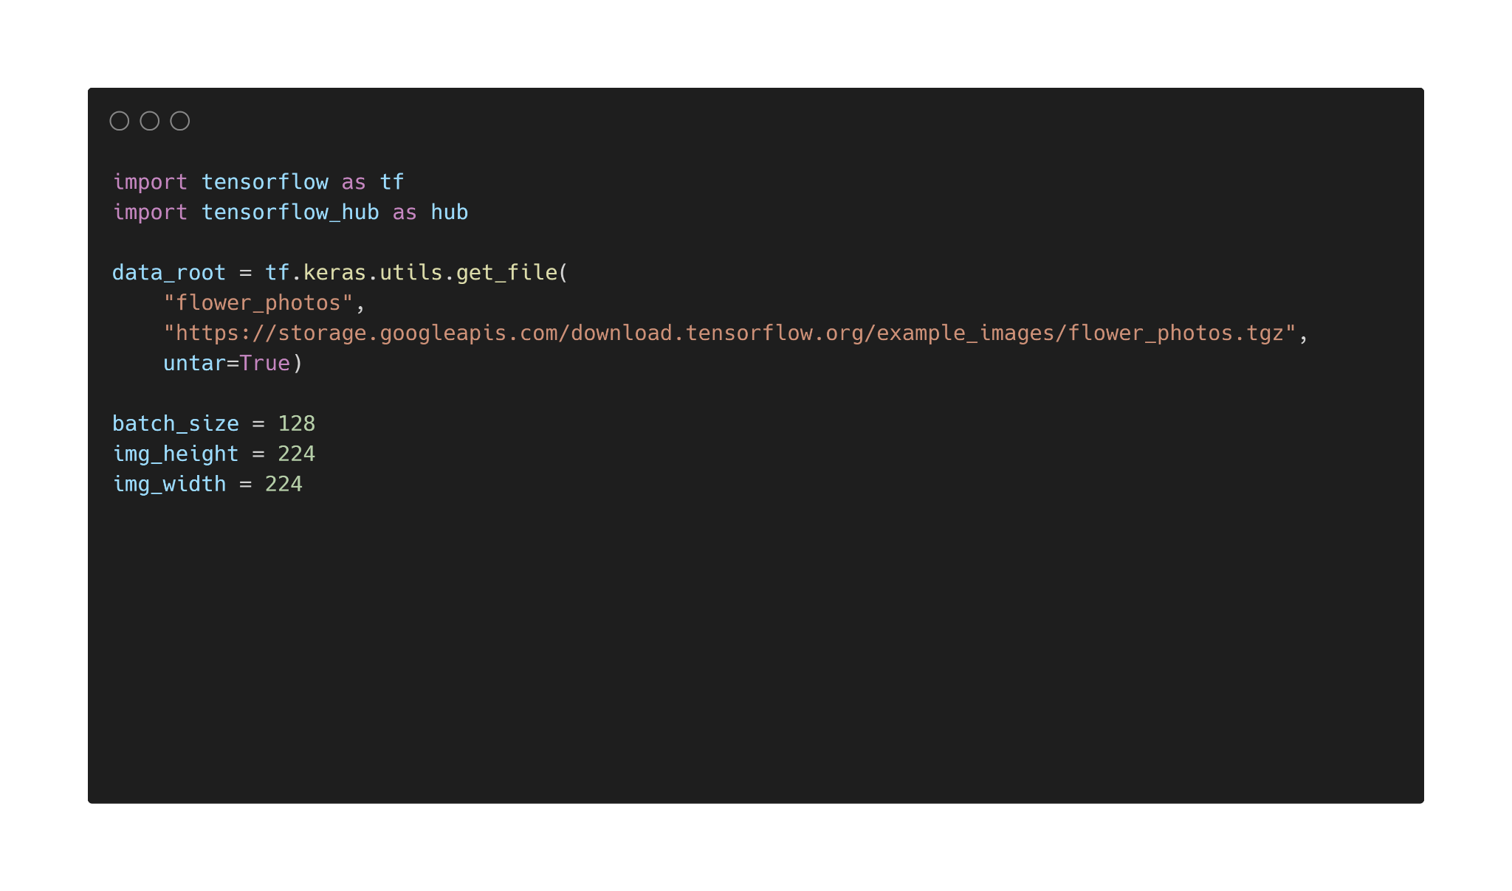

Slide 26
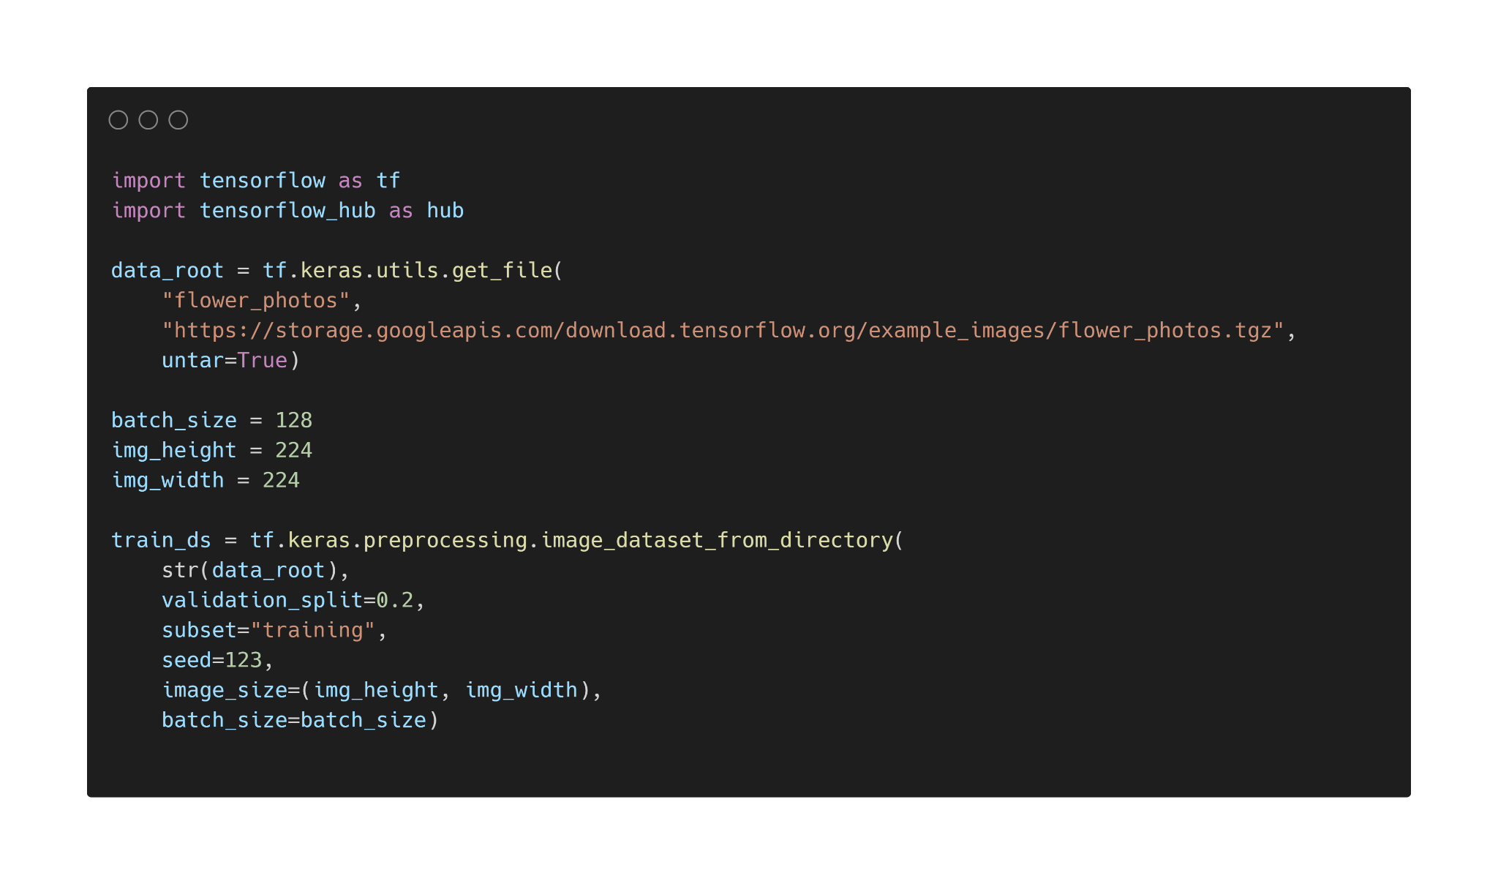

Slide 27
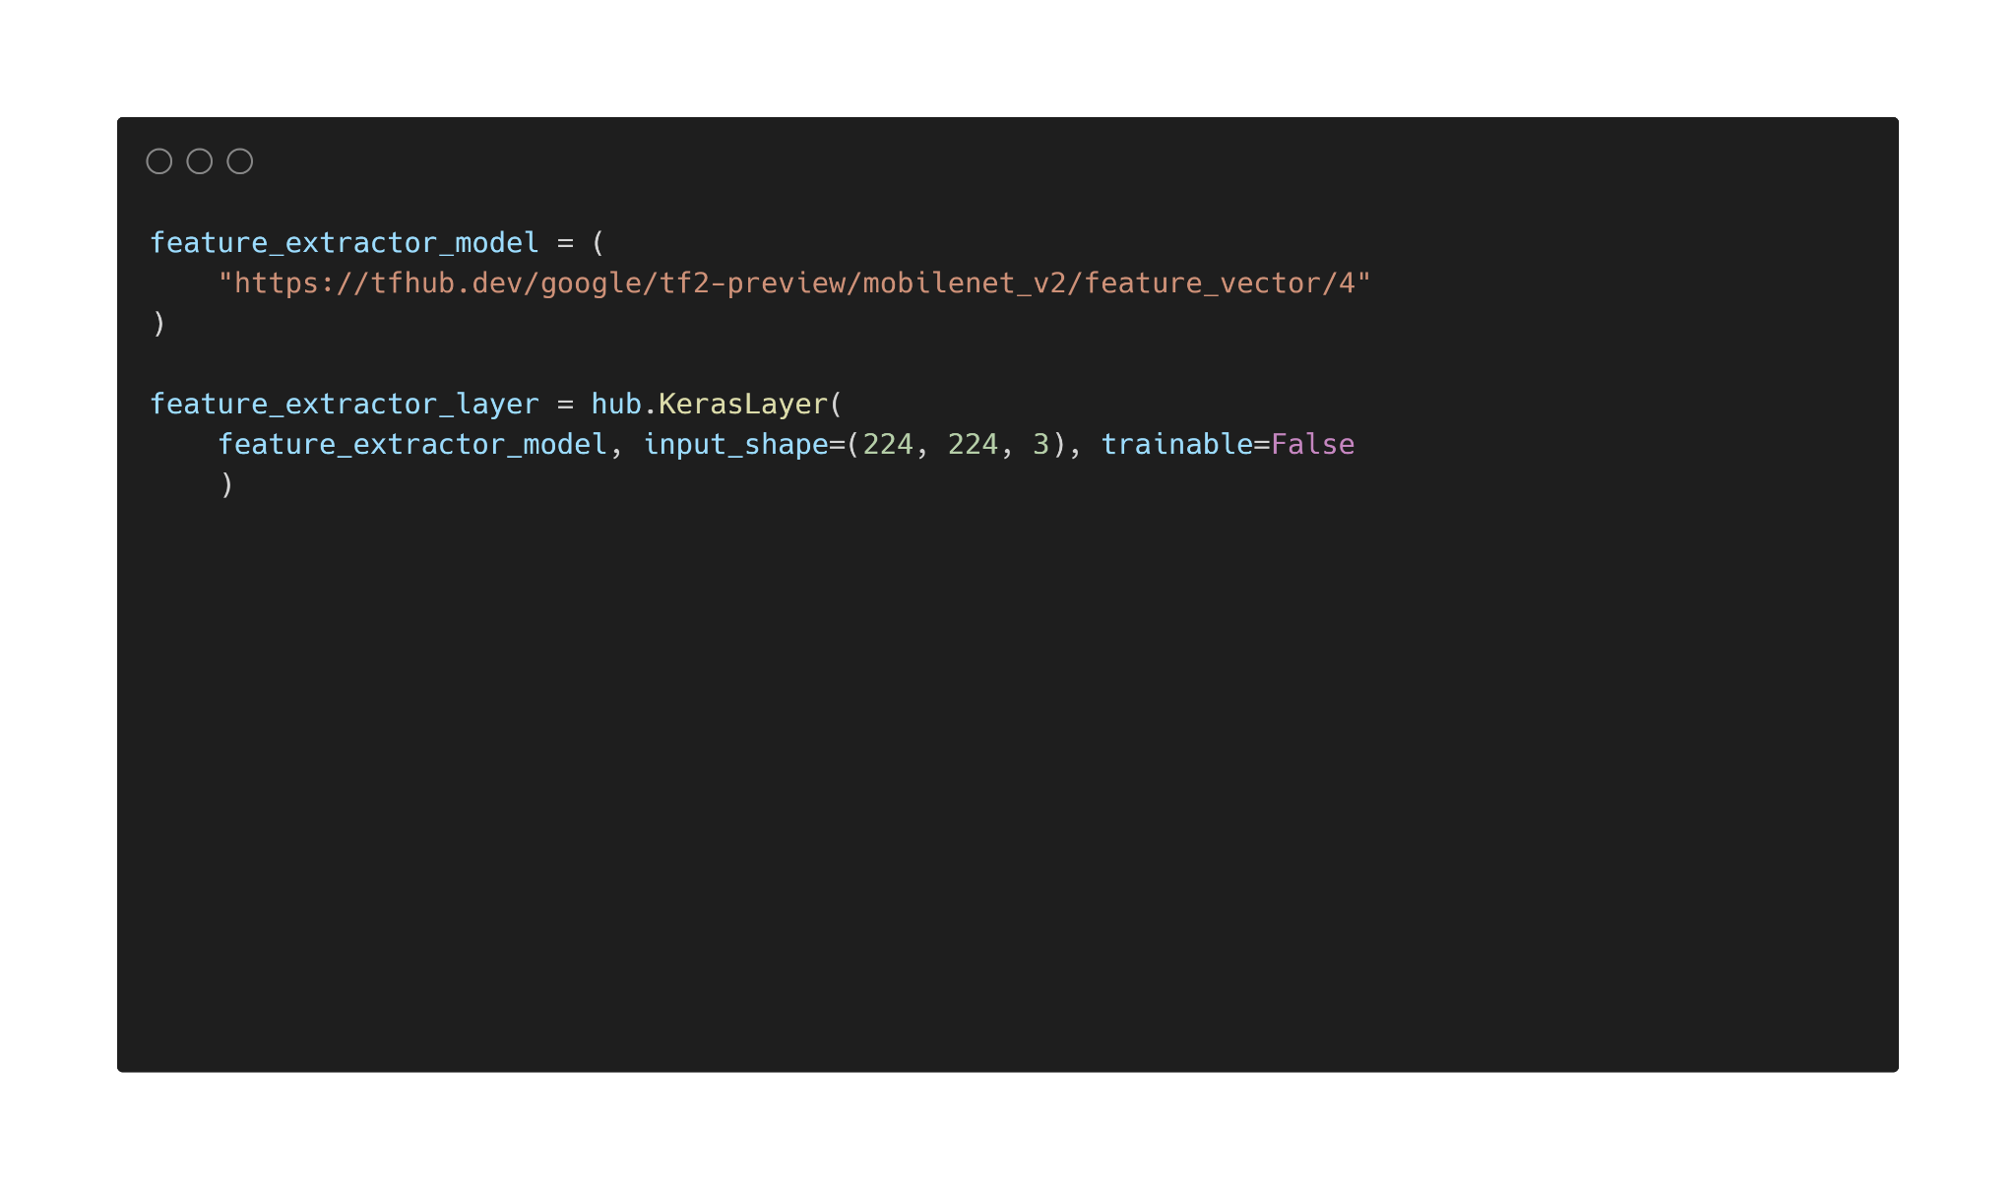

Slide 28
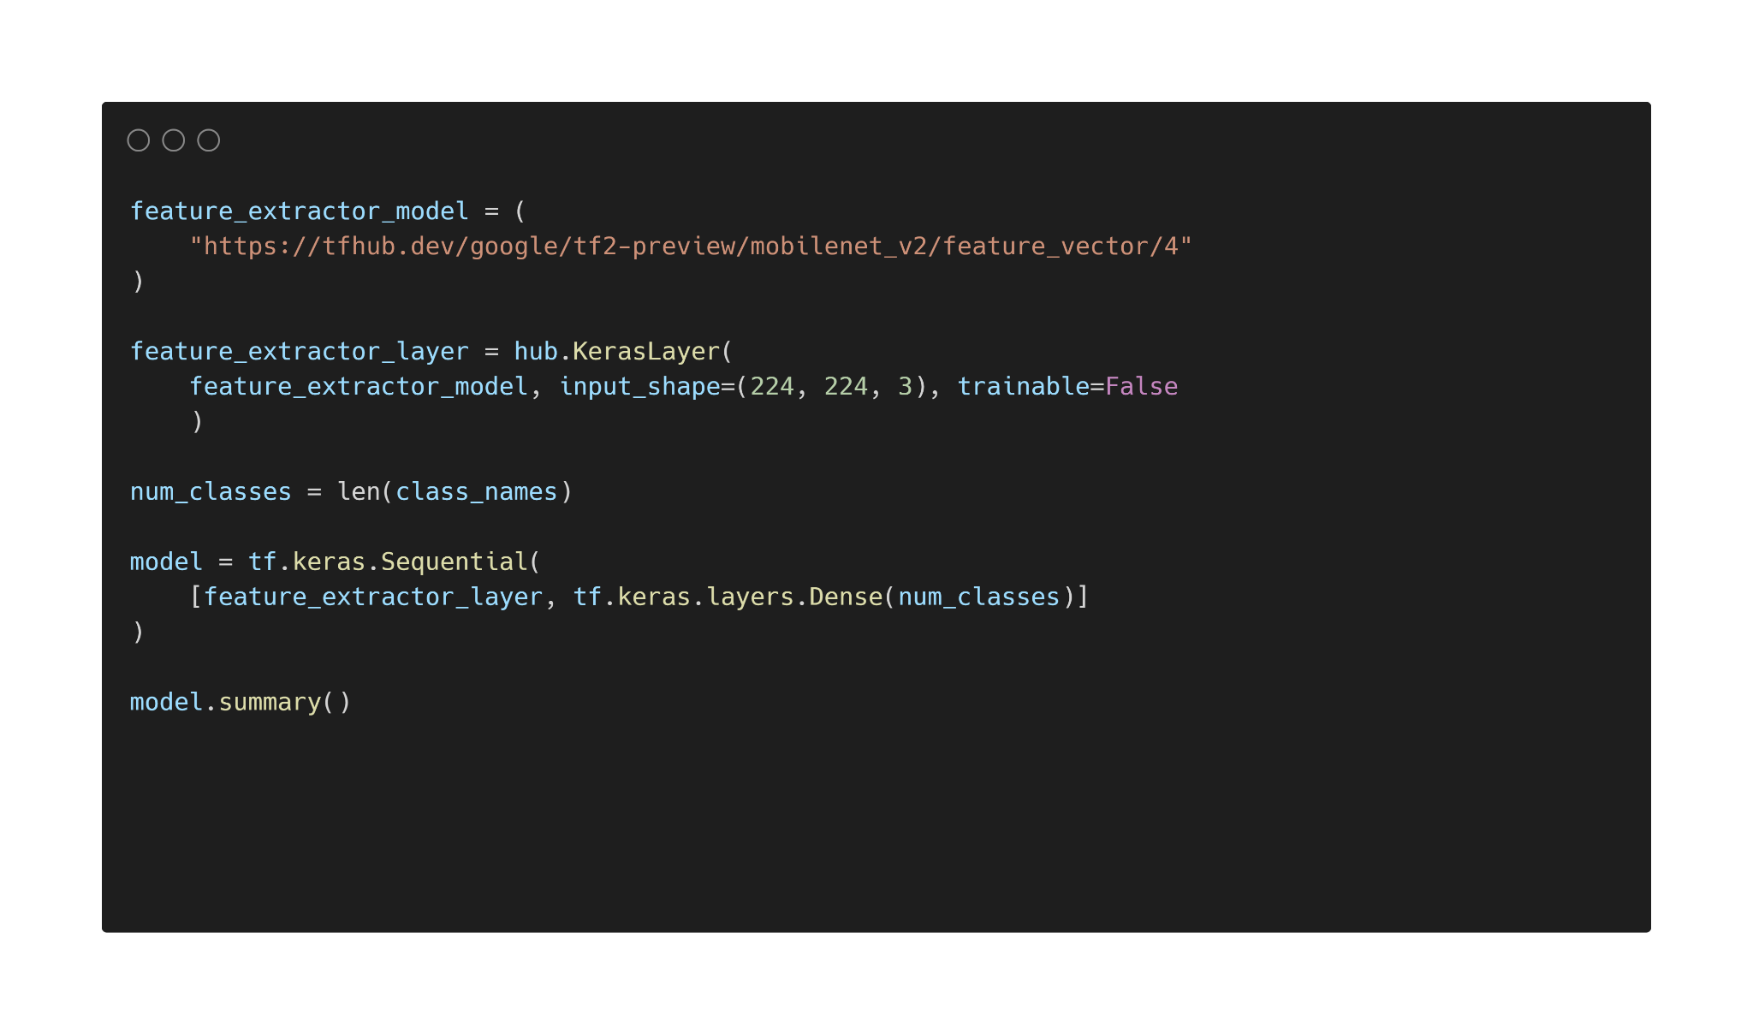

Slide 29
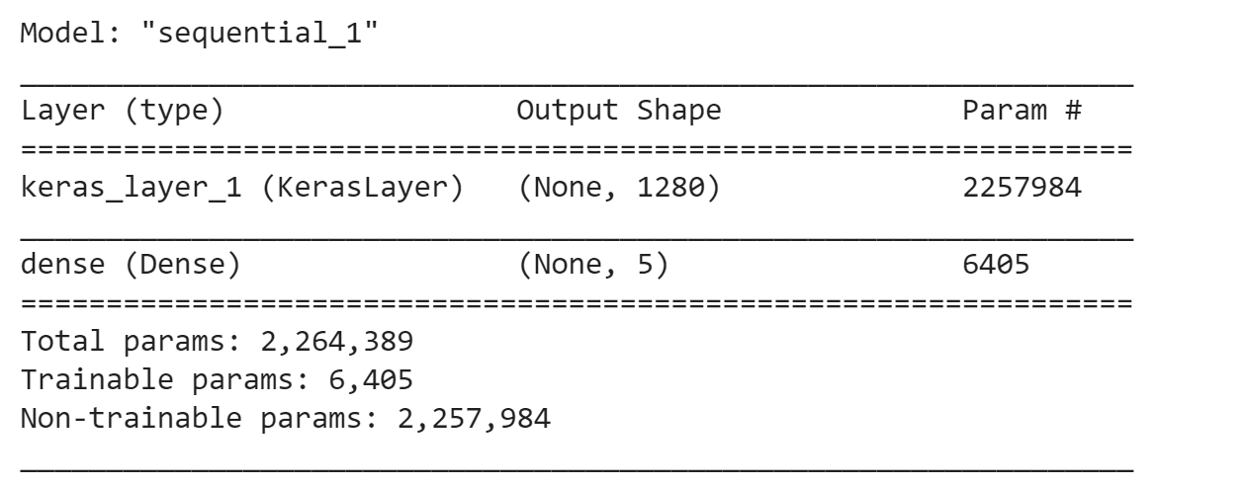

Slide 30
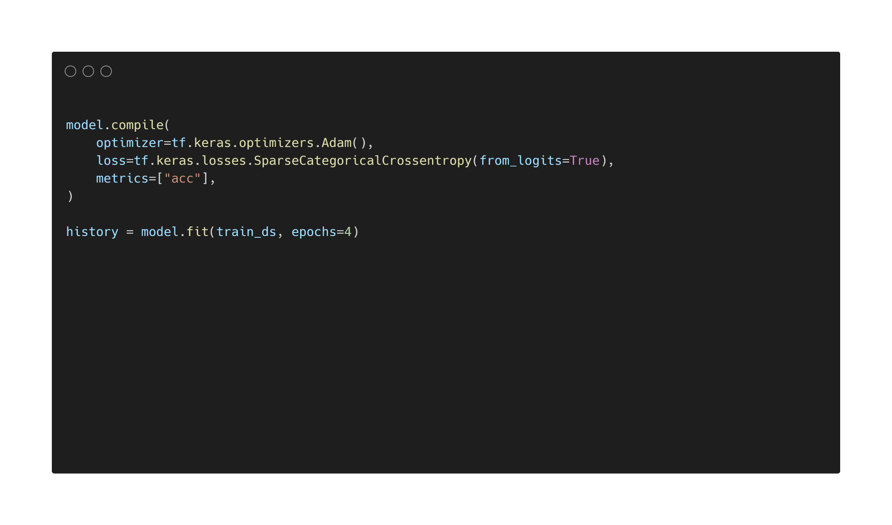

Slide 31
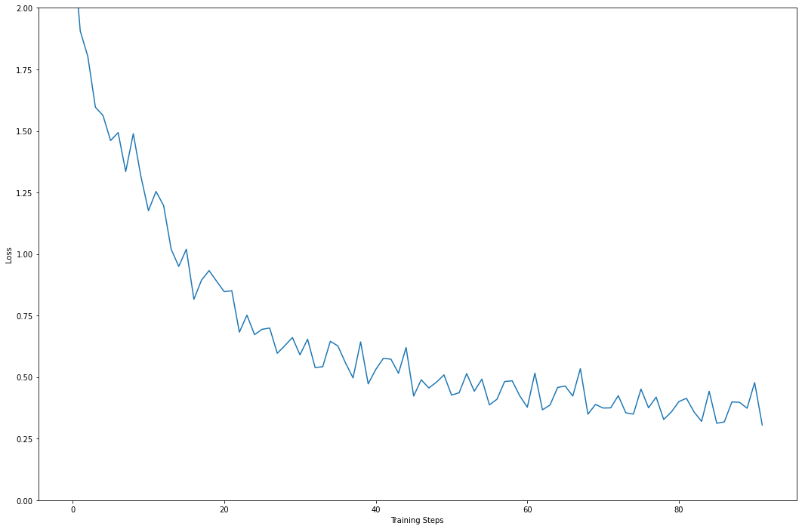
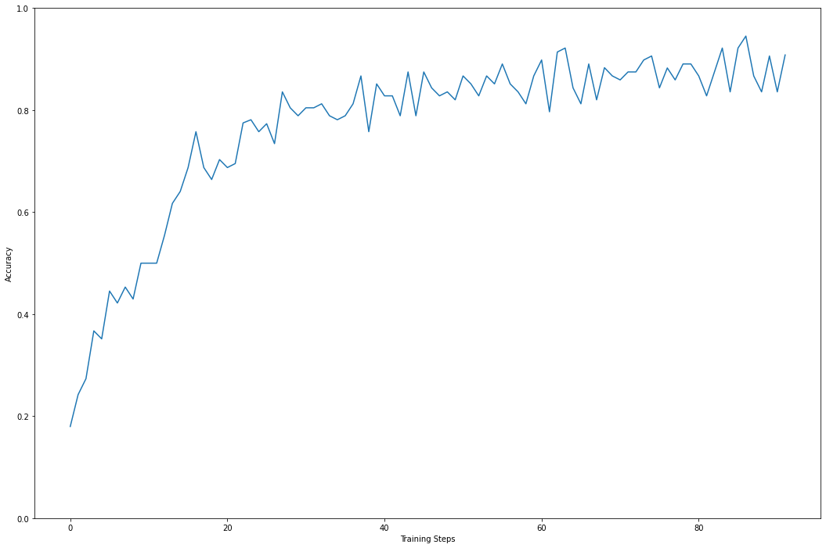
Loss
Accuracy

Slide 32
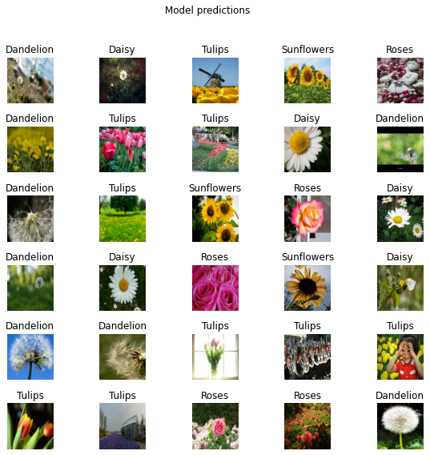
86.7%
Accuracy on Unseen Data

Slide 33
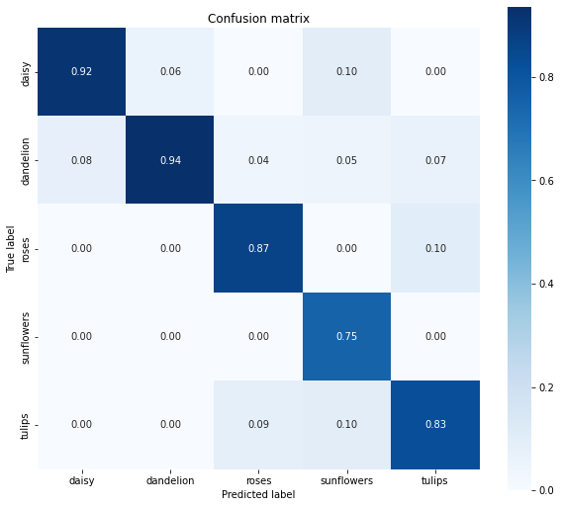

Slide 34
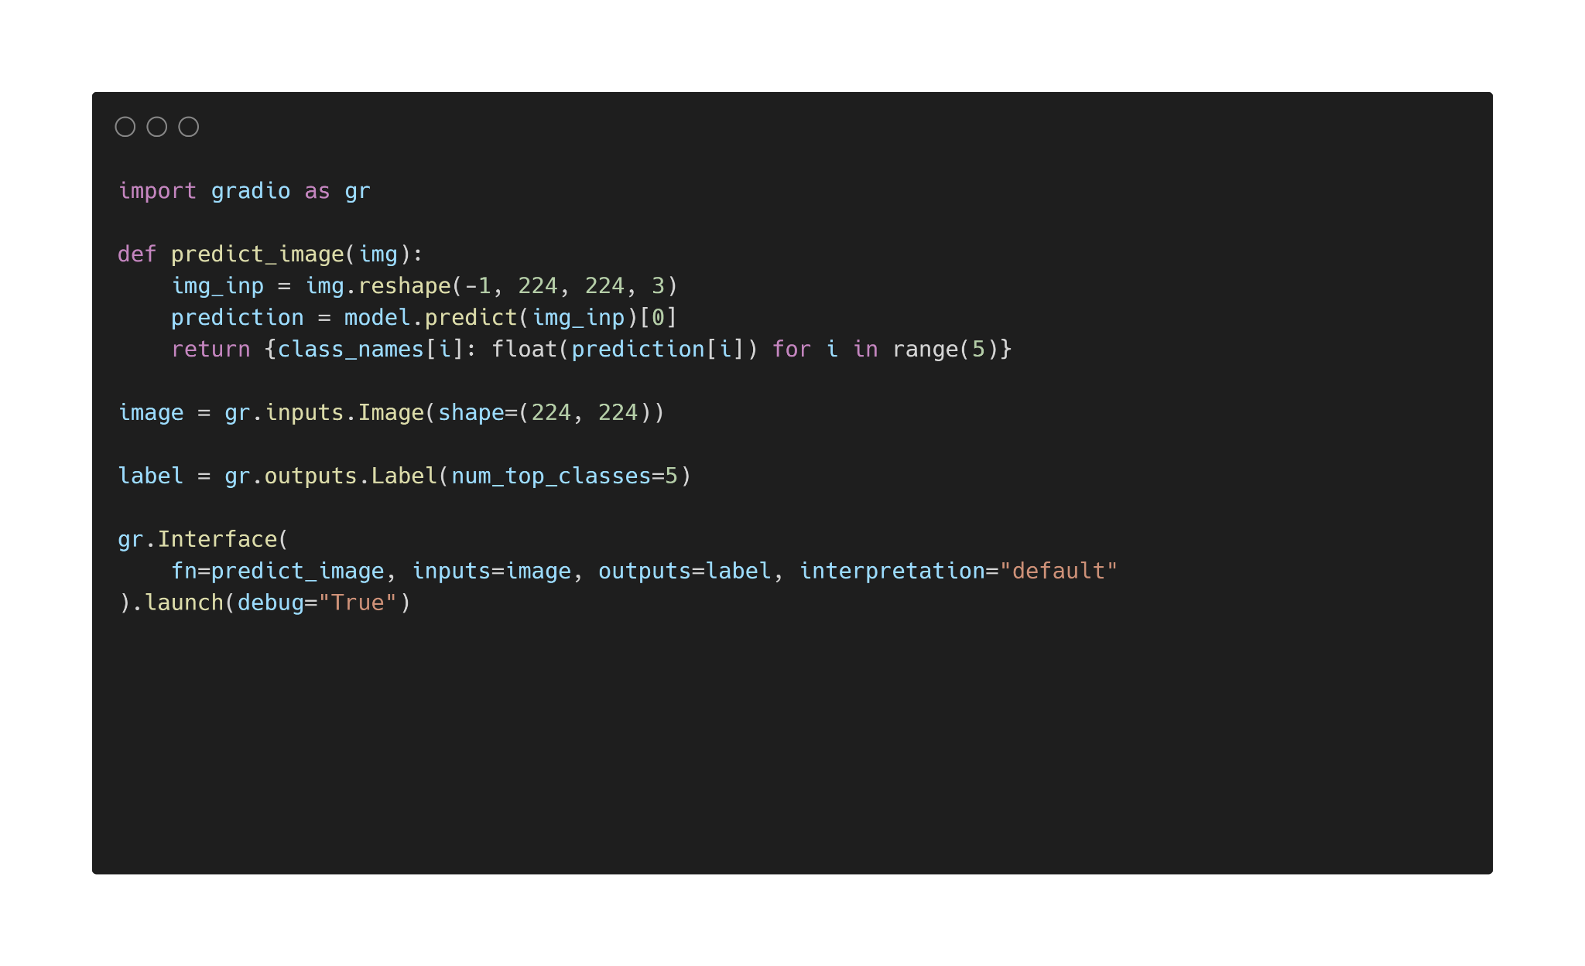

Slide 35
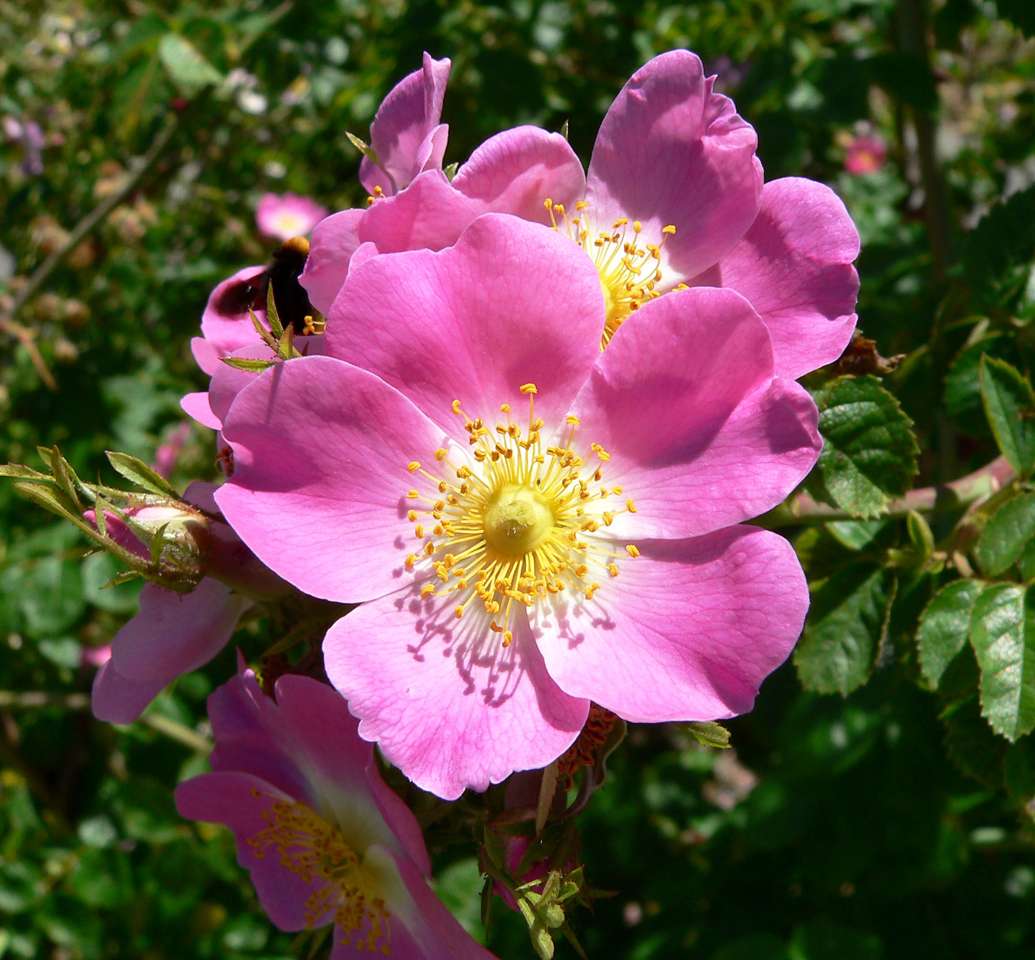
Image Source : Wikimedia.org

Slide 36
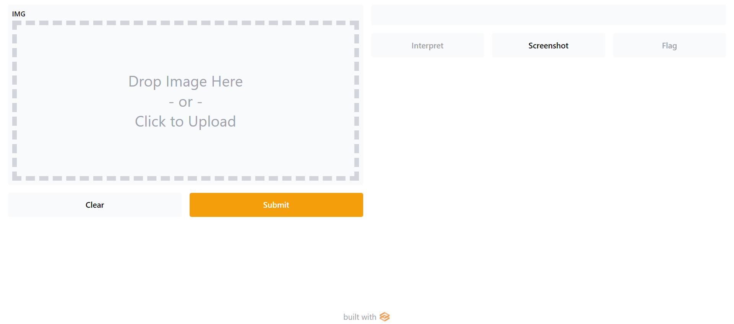

Slide 37
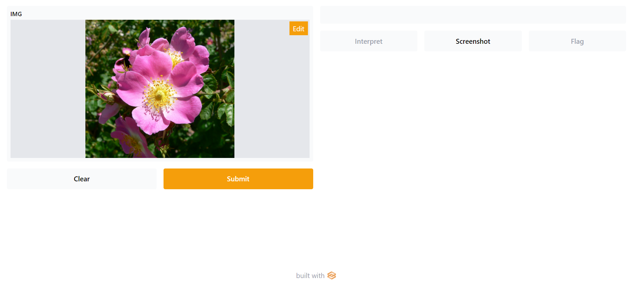

Slide 38
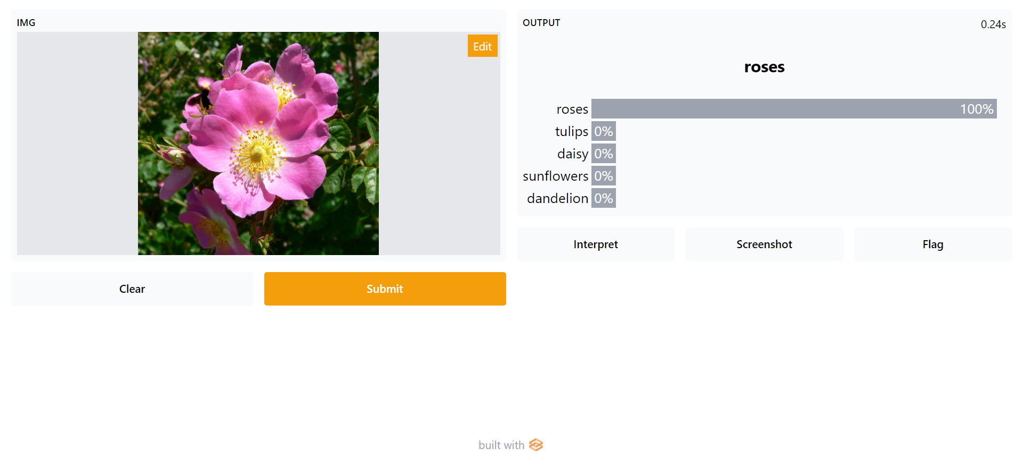

Slide 39

Thank You

